Slide 1

Android
A software platform and operating system for mobile devices
Based on the Linux kernel
We can find Android in Tab, Television, set top box, watches, etc
Android is a rich application framework that allows to develop innovative Apps and games for mobile devices
Java is the official development language for android, Google I/O 2017 google Introduced Kotlin

Slide 2
Android
Android is developed by Open Handset Alliance led by Google
Android is an open source operating system based on Linux kernel
Android uses a special virtual machine to run the apps called Dalvik virtual machine
Android apps can be made available for users through google play store
Android Studio is the official IDE for Android development
Java will be used as the programming language
Notes:
(java class is compiled to javabytecode. Virtual machine is needed to execute javabytecode)

Slide 3
What is Open Handset Alliance?
Quoting from www.OpenHandsetAlliance.com page
“… Open Handset Alliance™, a group of 47 technology and mobile companies have come together to accelerate innovation in mobile and offer consumers a richer, less expensive, and better mobile experience.
Together we have developed Android™, the first complete, open, and free mobile platform.
We are committed to commercially deploy handsets and services using the Android Platform. “

Slide 4

What is Open Handset Alliance?
What is the Open Handset Alliance (OHA)?
→ It's a consortium of several companies
Google Android

Slide 5
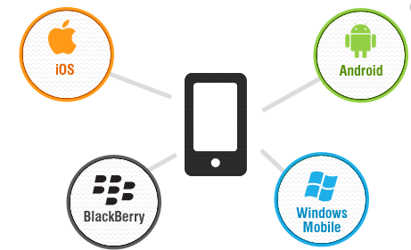
What are other Mobile platforms or Mobile Operating Systems?
Popular Mobile Operating Systems
Android OS (Google Inc.)
Bada (Samsung Electronics)
BlackBerry OS (Research In Motion)
iPhone OS / iOS (Apple)
MeeGo OS (Nokia and Intel)
Palm OS (Garnet OS)
Windows Mobile (Windows Phone 7)
Notes:
An operating system (OS) is an interface between hardware and user. It manages hardware and software resources of the system.
An operating system which controls mobile devices is called Mobile OS. They are simple and deal with the
wireless versions of broadband and local connectivity

Slide 6
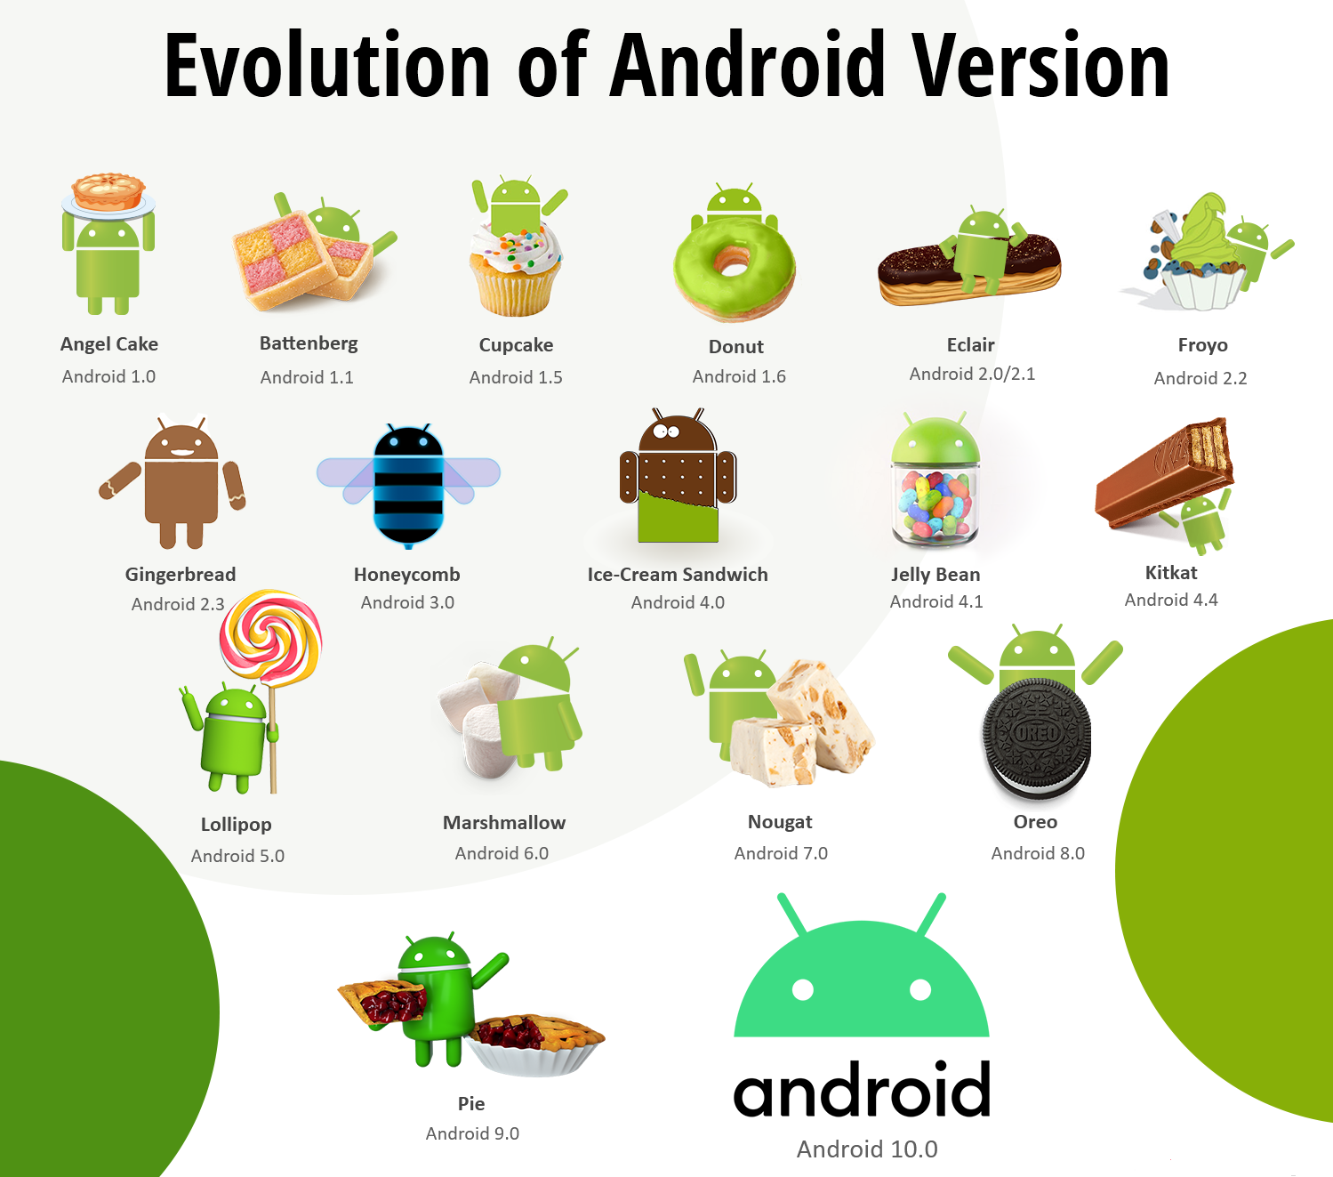
Android Platform versions

Slide 7
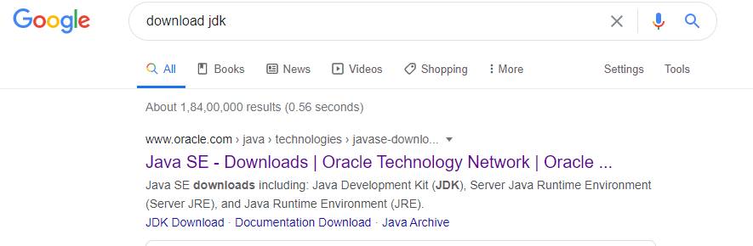
Android Installation
Download JDK and install
Download Android Studio and install
Demonstration

Slide 8
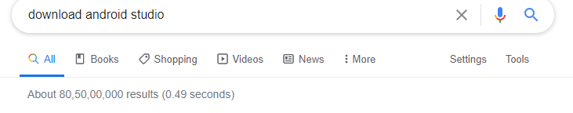
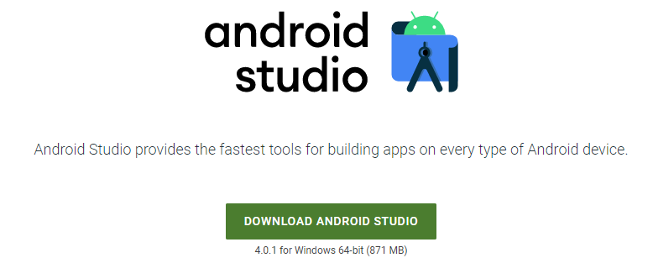
Android Installation

Slide 9
Android
Demonstration of working on the IDE.
Hello world example execution

Slide 10
Android
Demonstration of working on the IDE.
Hello world example execution

Slide 11
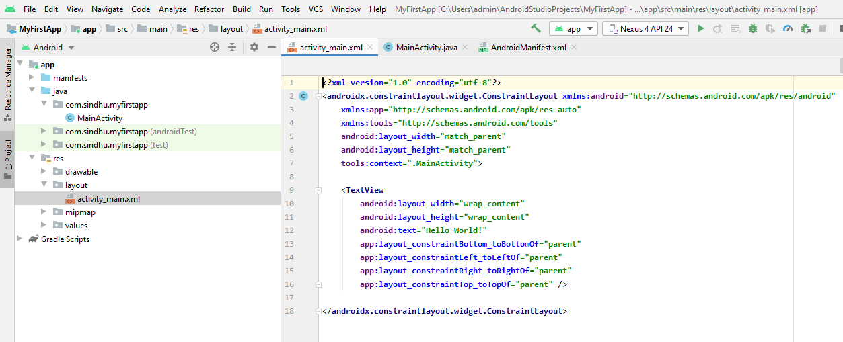
App Fundamentals: “Hello World” App
The activity_main.xml is a layout file available in res/layout directory, that is referenced by your application when building its interface. You will modify this file very frequently to change the layout of your application.

Slide 12
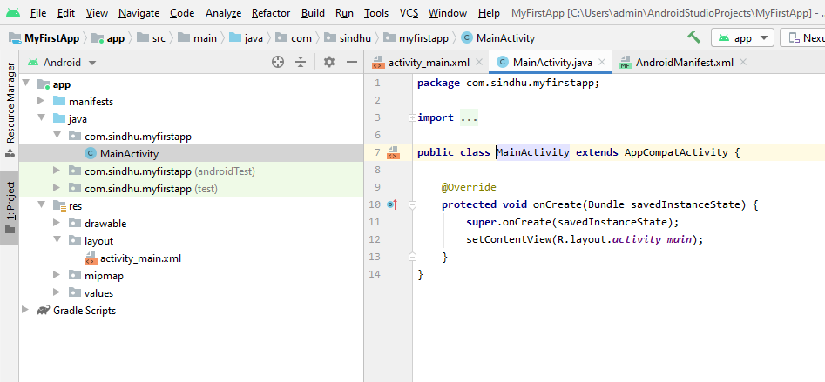
App Fundamentals: “Hello World” App
The main activity code is a Java file MainActivity.java. This is the actual application file which ultimately gets converted to a Dalvik executable and runs your application.

Slide 13
Four main components of Android
Activity: A “single screen” that’s visible to user
Service: Long-running background “part” of app (not separate process or thread)
ContentProvider: Manages app data (usually stored in database) and data access for queries
BroadcastReceiver: Component that listens for particular Android system “events”, e.g., “found wireless device”, and responds accordingly

Slide 14
App Manifest
Every Android app must include an AndroidManifest.xml file describing functionality
The manifest specifies:
App’s Activities, Services, etc.
Permissions requested by app
Minimum API required
Hardware features required, e.g., camera with autofocus
External libraries to which app is linked, e.g., Google Maps library

Slide 15
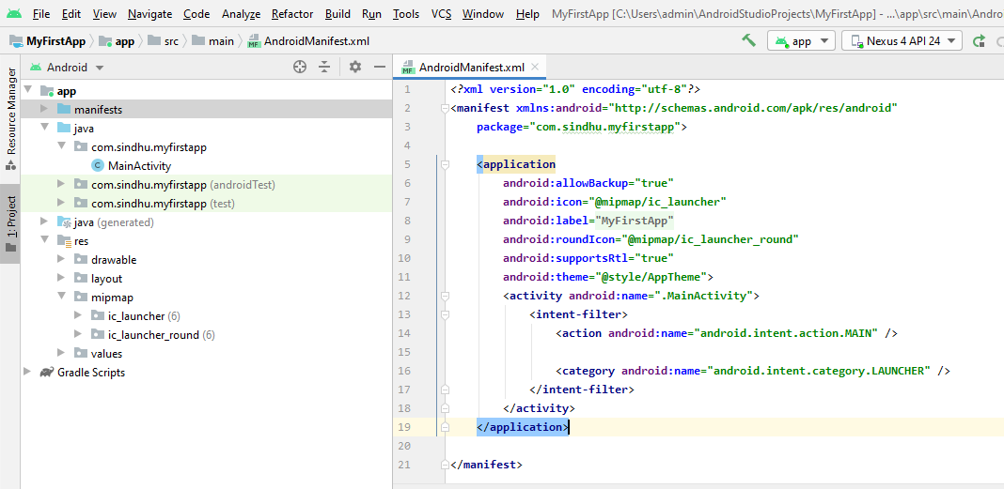
AndroidManifest.xml

Slide 16
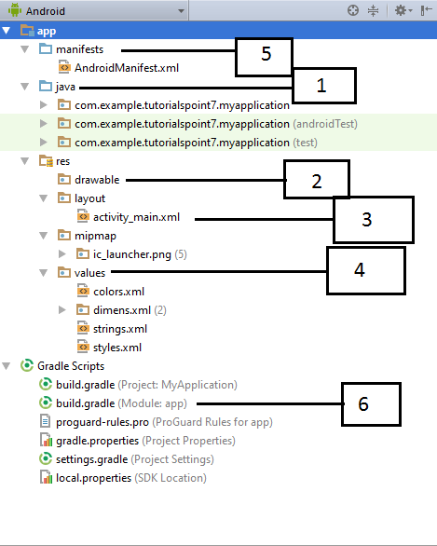
Structure of Android Application
Before we run our app,
we should be aware of a
few directories and files
in the Android project.
Each project module appears
as a folder at the top level
of the project hierarchy
and contains these three
elements at the top level:
java/ :
Source files for the module.
manifests/ :
Manifest files for the module
res/ :
Resource files for the module
Notes:
https://www.tutorialspoint.com/android/android_hello_world_example.htm

Slide 17
Sl.No. | Folder, File & Description
1 | Java: This contains the .java source files for your project. By default, it includes an MainActivity.java source file having an activity class that runs when your app is launched using the app icon.
2 | res/drawable-hdpi: This is a directory for drawable objects that are designed for high-density screens.
3 | res/layout: This is a directory for files that define your app's user interface.
4 | res/values: This is a directory for other various XML files that contain a collection of resources, such as strings and colours definitions.
5 | AndroidManifest.xml: This is the manifest file which describes the fundamental characteristics of the app and defines each of its components.
6 | Build.gradle: This is an auto generated file which contains compileSdkVersion, buildToolsVersion, applicationId, minSdkVersion, targetSdkVersion, versionCode and versionName

Slide 18
What is activity_main.xml in android?
It has information about layout in an application
What is MainActivity.java in android?
It has the information about activities in an application

Slide 19
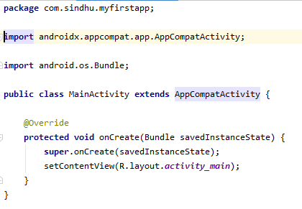
What is Activity?
An activity represents a single screen with a user interface. For example, an email application might have one activity that shows a list of new emails, another activity to compose an email, and one for reading emails. If an application has more than one activity, then one of them should be marked as the activity that is presented when the application is launched.For example, MainActivity class is subclassing a super class called as a AppCompatActivity

Slide 20
MainActivity.java
Next we will learn about R.layout.activity_main in the file MainActivity.java

Slide 21
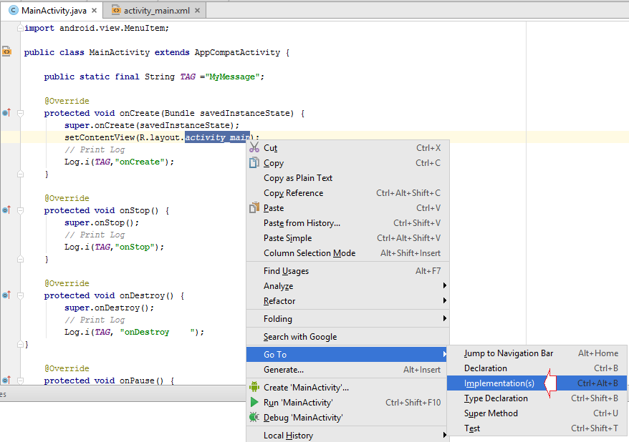
R.java file
When we see on the Project window, not all components involved creating your application is visible. There are components that are generated automatically by the compiler program. And it does not display on Project window. For example, based on the structure of the source files in your project, the compiler creates a R.java source file that defines constants for the resources on the project.
To view the R.java file on Android Studio, open MainActivity class, right click on R.layout.main_activity and select Go To/Implementation (s)
Notes:
http://o7planning.org/en/10415/android-tutorial-for-beginners-hello-android

Slide 22
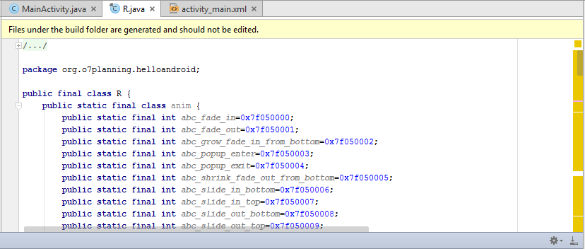
R.java file

Slide 23
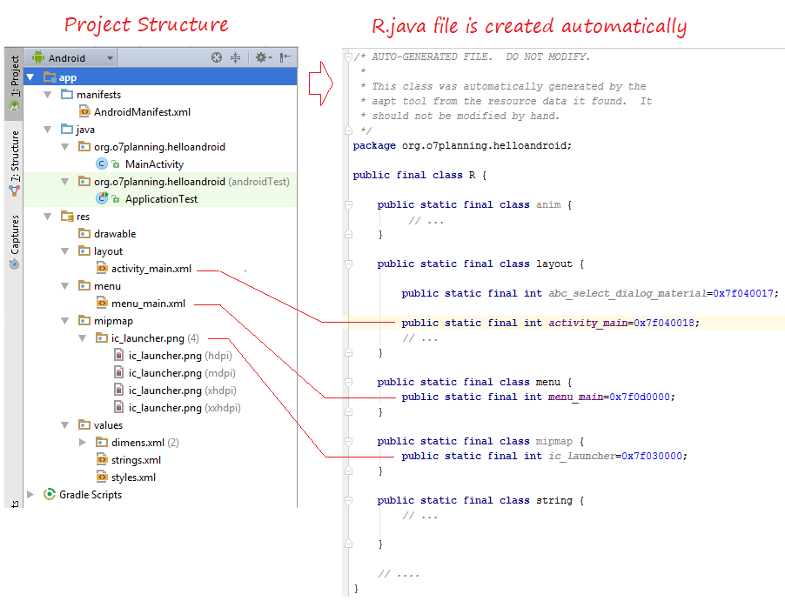
R.java
The constants defined in class R.java are created corresponding to the resources on the Project:

Slide 24
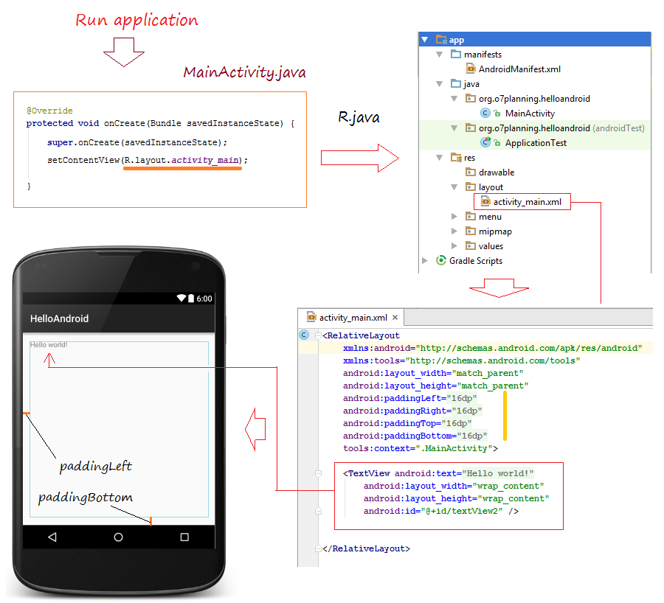
R.java
So somewhere in the Project, you can use the constants to refer resources in the project. Such as, R.layout.activity_main is a constant which refers activity_main.xml file in the res/layout folder.

Slide 25
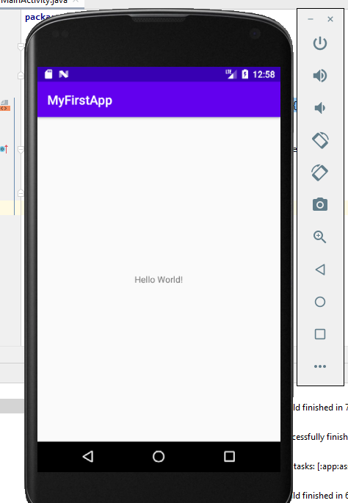
Android Emulator

Slide 26
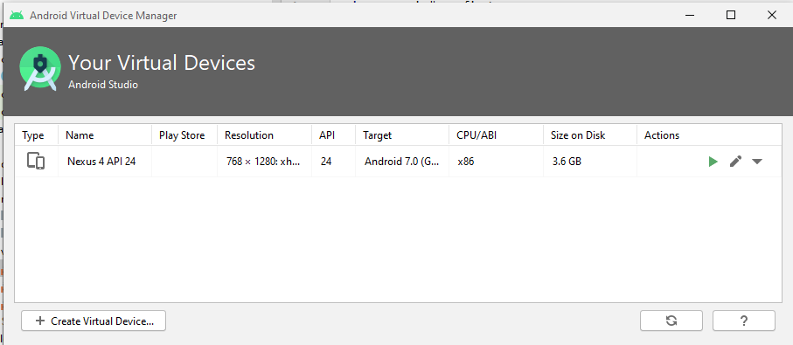
Android Emulator

Slide 27
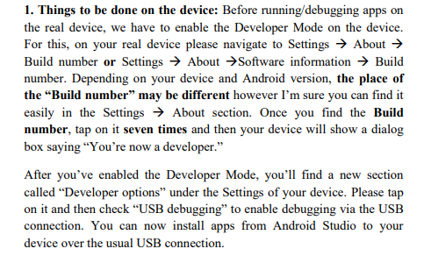
Android Device

